Slide 1

Instructor Kick-off
Analyze A/B Test Results
© 2019 Udacity. All rights reserved.

Slide 2
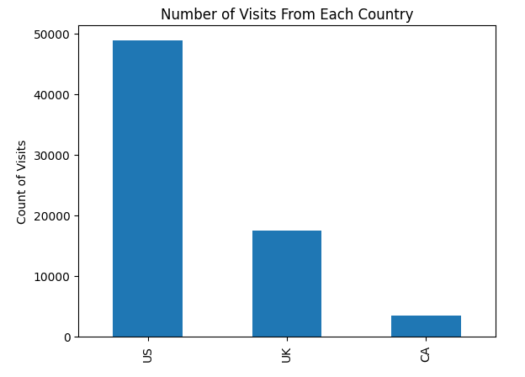
How Was The Experiment Implemented?​
Total Variant Visitors: 35,211
Total Control Participants:​ 34,678​

Slide 3
Conversion Rates
 | U.S. | U.K. | CA
Control | 10.7% | 10.1% | 9.4%
Treatment | 15.8% | 14.9% | 15.4%
Executive Summary:
Analyzing the probabilities within each country. The data shows the treatment group has higher conversion rates. The average treatment conversion rate it for all countries is 15.1% where as Control group average is 10.1%

Slide 4
Experiment Results
Treatment Conversion Rate: 0.1553
Control Conversion Rate:​ 0.1053
Delta in Treatment vs. Control Conversion Rate:​ 0.05
p-value:​ 0
Conclusion:​ The p-value is less that 0.05 which implies that new page (Treatment) is more effective than old page (Control)
The difference between these two pages is 0.05. The new page leads to a 5% increase compared to old page

Slide 5
Country Results
Conclusion:​
- For UK, The p-value is 0.905
- For US, The p-value is 0.170
Both countries (US & UK) p-value are above 0.05 which is the determining point meaning that neither of them have an significant impact when compared to CA.
After testing more models
The 3 models we tested all show CA is not statistically significant.

